Slide 1
West Africa Mobile App for sustainability
Team Saltine*

Slide 2
Problem Statement
Develop a mobile application that allows fishers to:
1) Send a registration request for their fishing vehicle
2) Send a licensing request
3) Report illegal fishing activities
4) Request help in emergency situations

Slide 3
Proposed solution
NFC Chips
Cloud Based Application
Simple and straight forward interface
Create Incentive

Slide 4
Stakeholders
Fishers
Fisheries
Central Administration
Law Enforcement

Slide 5
Tools
Near field communication (NFC) chips
Android Phones (with GPS/camera)
Android Tablets
Central Servers (Cloud Based)

Slide 6
Features
Fishers
Registration Request
Incident Reporting
Information (weather forecast, fish prices etc.)
Direct SOS line to police/coast guard
Fisheries
Ability to register new fishers
Information
Fish Analytics
Central Administration
ID trace for each canoe and database of all active fishing canoes
geo-tagging for incident reporting (i.e. emergency, illegal activities)
Fish Analytics
Police
Incident reports and precise location of illegal activities

Slide 7
Data exchange between parties involved
Database
Fish price, weather forecast etc.
Closes Incident Cases
Registration Info. Incident Reports
Receives fisherman info.
Receives Fish Activity Data
Receives Incident Reports
Uploads Fishing Activity Data
Compute & Upload Fish Analytics
Fisherman
Fisheries
Central Authority
Police

Slide 8
Assumptions
The State Department will provide local fishers with android smartphones, and fisheries with android tablets
Fishing vehicles operate within 3 miles from the shore and can access cellular service
Existing Licensing and registration database
Available emergency response
Corresponding fishmonger measuring/weighing the fish catches
Application can be translated to the local language
Illegal fishing activities include: light fishing, fishing with chemicals, dynamite fishing, fishing endangered species

Slide 9
Innovation
Simplify Incentive Utilize

Slide 10
Implementability
Agile Development
Cost Effective Identification Device
Utilizes current wireless infrastructure
Utilizes current compliance methods
Promotional effort

Slide 11
Impact
Thanks to the affordability and simplicity of the design and process, authorities will be able to distribute the solution with ease to the 30,000 fishers of West Africa. In addition, the incentives included will increase the utility of the app allowing farmers to be more willing to adapt. With increased interaction between agency and fishers we can help increase awareness, corporation, and effectiveness among all stakeholders

Slide 12
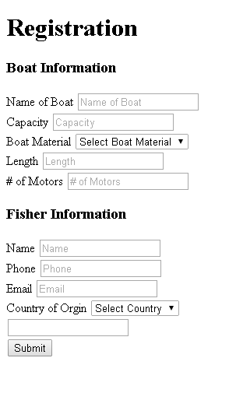
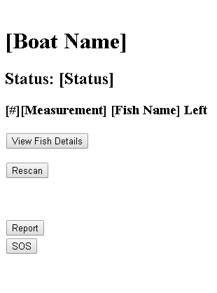
Interface

Slide 13
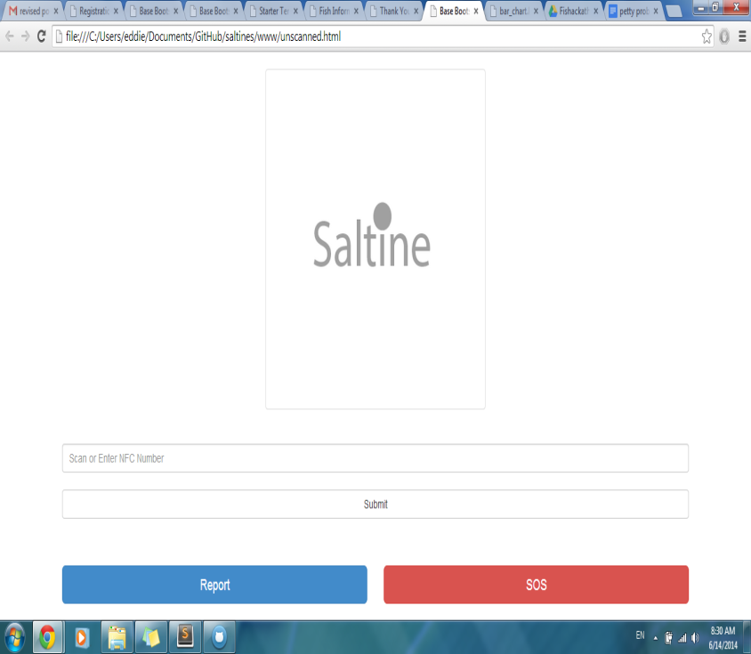
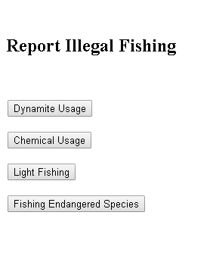
Interface Cont.

Slide 14
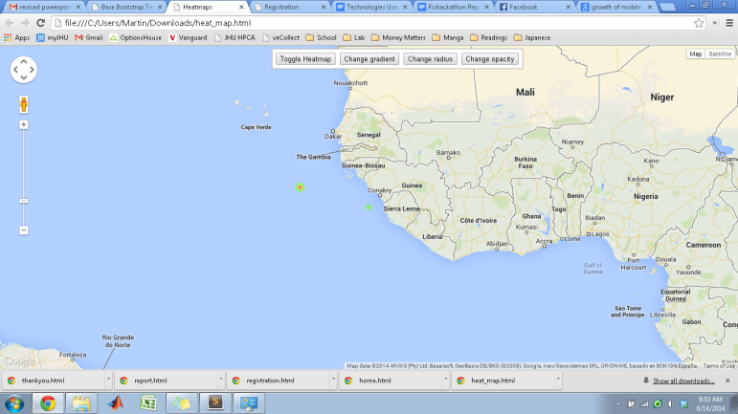
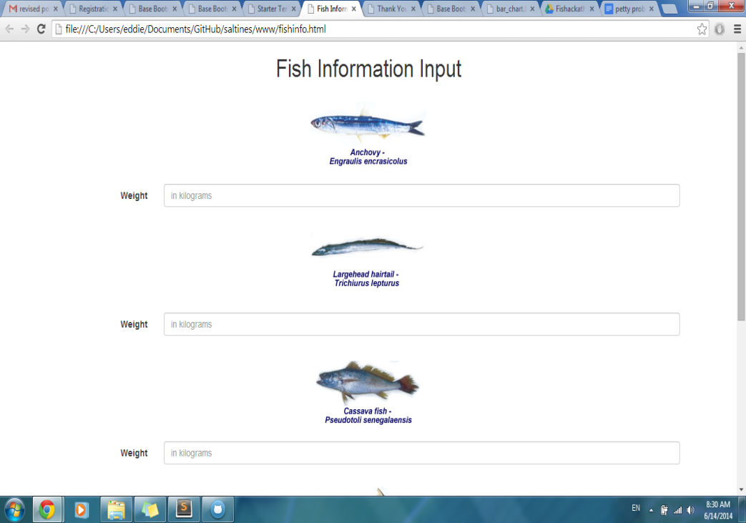
Interface Cont.

